Slide 1

Цифровая и микроконтроллерная техника
Vlasov Sergey
smvlasov@itmo.ru

Slide 2
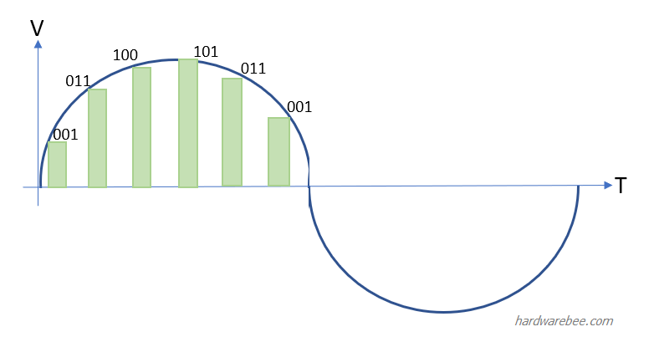
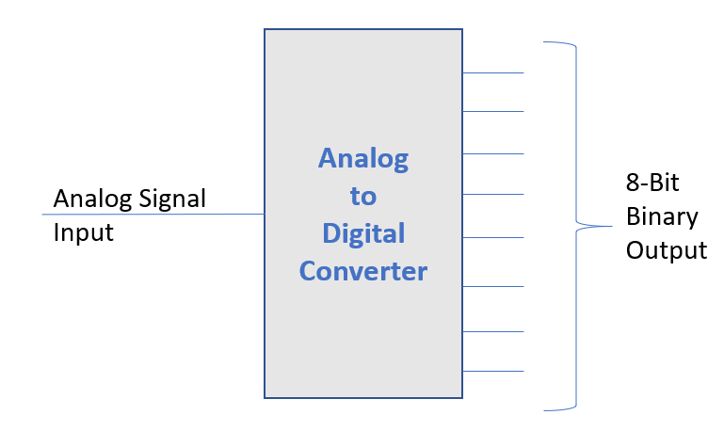
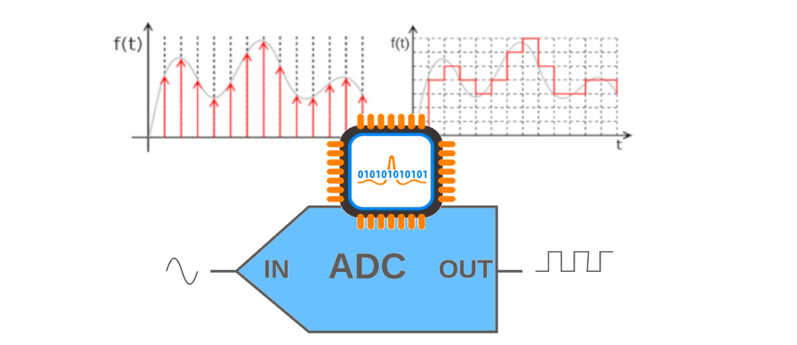
Analog to Digital Converter

Slide 3
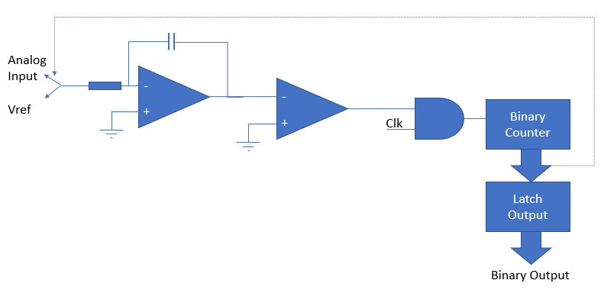
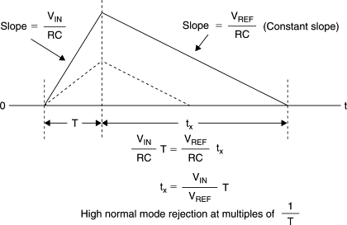
Dual Slope Analog to Digital Converter
Integrator

Slide 4
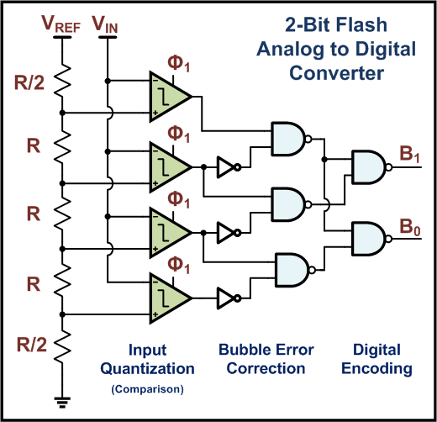
Flash Analog to Digital Converter

Slide 5
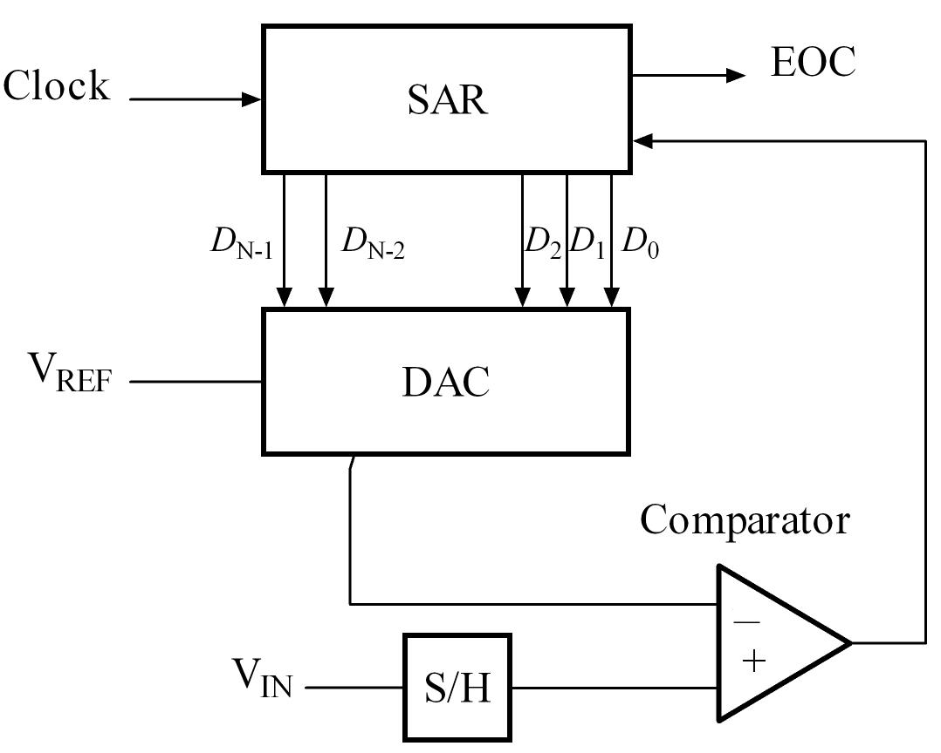
Successive Approximation Analog to Digital Converter
A sample-and-hold circuit to acquire the input voltage V_{in}.
An analog voltage comparator that compares V_{in} to the output of the internal DAC and outputs the result of the comparison to the successive-approximation register (SAR).
A successive-approximation register subcircuit designed to supply an approximate digital code of V_{in} to the internal DAC.
An internal reference DAC that, for comparison with V_{ref}, supplies the comparator with an analog voltage equal to the digital code output of the SAR_{in}.

Slide 6
Successive Approximation Analog to Digital Converter

Slide 7
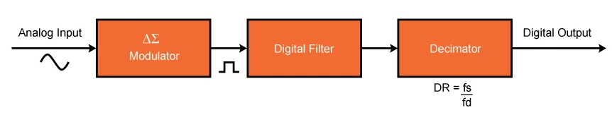
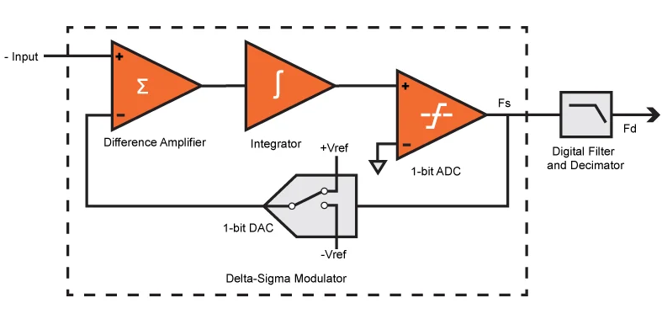
Sigma Delta Analog to Digital Converter

Slide 8
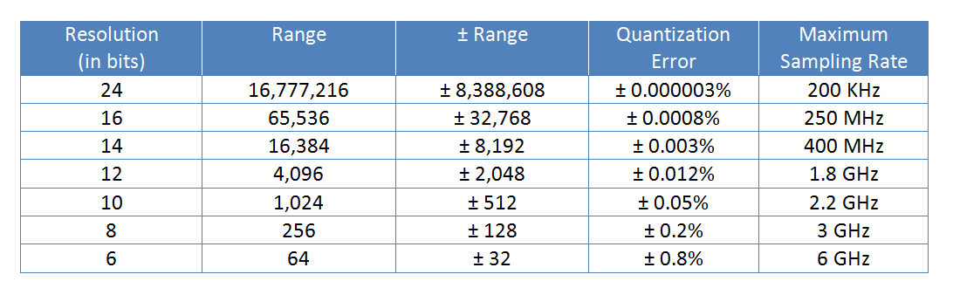
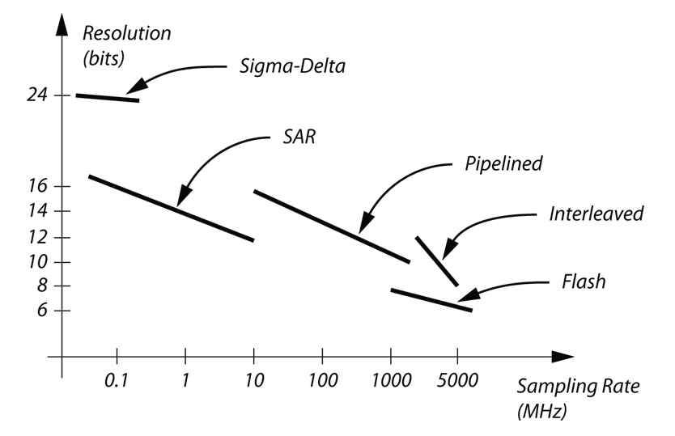
ADC resolution vs Max sampling rate

Slide 9
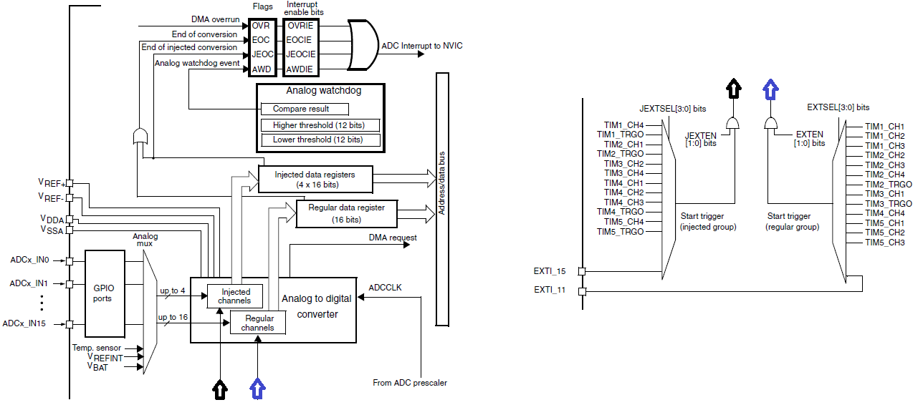
STM32 ADC

Slide 10
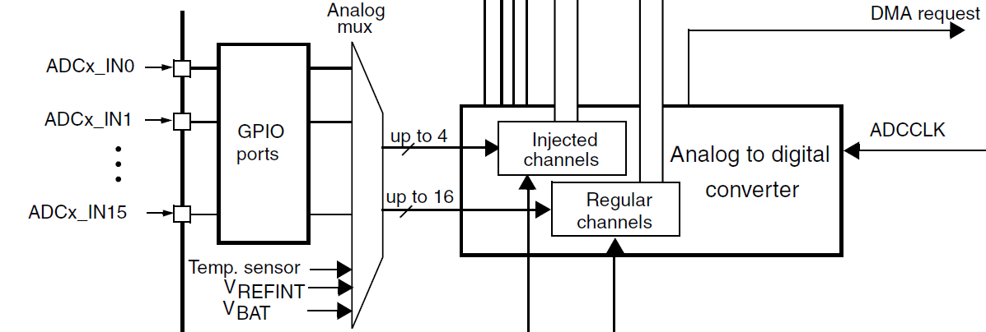
STM32 ADC
A/D conversion can be:
Single Conversion. One sample conversion at a given instant.
Continuous Conversion. Non-stop sample collection and conversion.
Discontinuous Conversion. Sequential conversion of some channels in a group.
Scan Conversion. Sequential sampling and converting of an array of channels one after another.
To start A/D conversion, an ADC unit needs to be stimulated with a trigger signal:
Software Trigger. A/D conversion as per demand from coded program.
Hardware Trigger. A/D conversion as per hardware events like external interrupts or timer events.

Slide 11
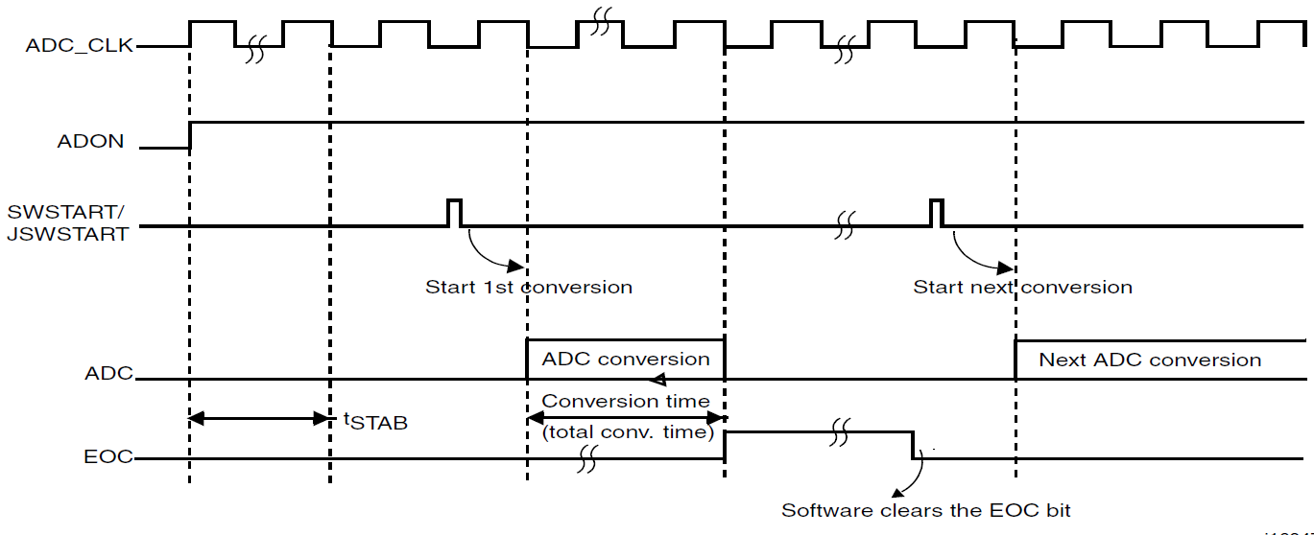
Timing diagram

Slide 12

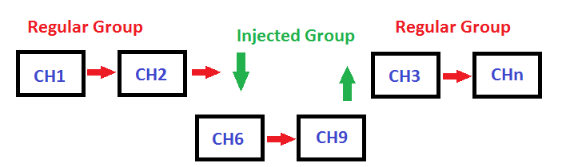
ADC Groups

Slide 13
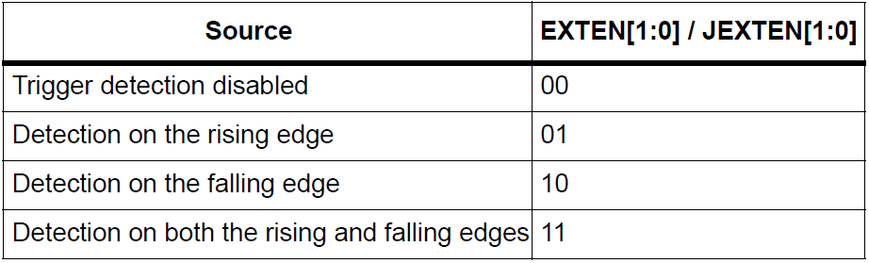
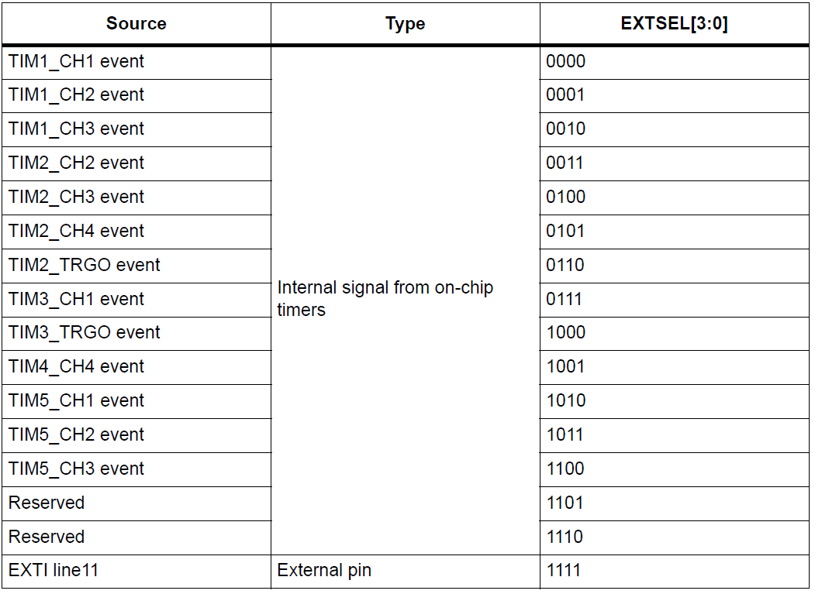
Conversion on external trigger and trigger polarity

Slide 14
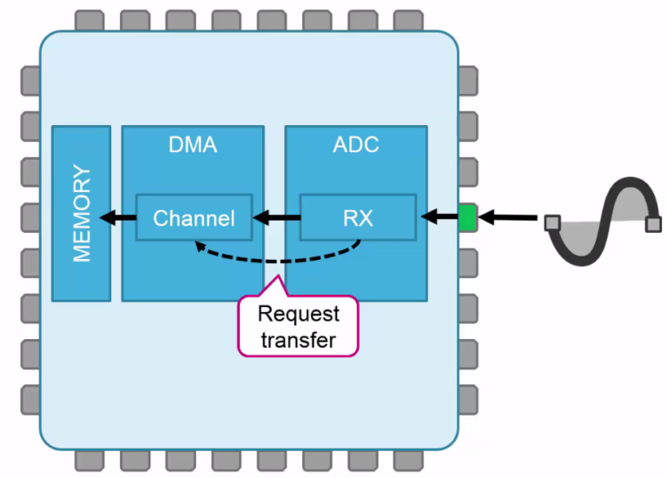
ADC with DMA

Slide 15
ADC registers
ADC status register (ADC_SR)
ADC control register 1,2 (ADC_CR1,2) ADC sample time register 1,2 (ADC_SMPR1,2)
ADC injected channel data offset register x (ADC_JOFRx) (x=1..4)
ADC watchdog higher/lower threshold register (ADC_{H/L}TR)
ADC regular sequence register 1,2,3 (ADC_SQR1,2,3)
ADC injected sequence register (ADC_JSQR)
ADC injected data register x (ADC_JDRx) (x= 1..4)
ADC regular data register (ADC_DR)
ADC Common status register (ADC_CSR)
ADC common control register (ADC_CCR)
ADC common regular data register for dual and triple modes (ADC_CDR)

Slide 16
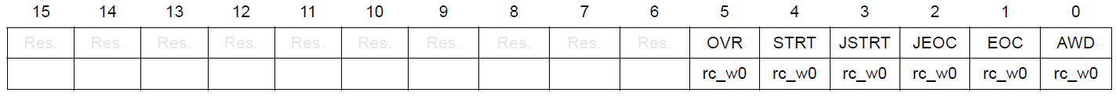
ADC registers
ADC status register (ADC_SR)
Address offset: 0x00
AWD: Analog watchdog flag
0: No analog watchdog event occurred
1: Analog watchdog event occurred
EOC: Regular channel end of conversion
0: Conversion not complete (EOCS=0), or sequence of conversions not complete (EOCS=1)
1: Conversion complete (EOCS=0), or sequence of conversions complete (EOCS=1)
STRT: Regular channel start flag
0: No regular channel conversion started
1: Regular channel conversion has started
OVR: Overrun
0: No overrun occurred
1: Overrun has occurred

Slide 17
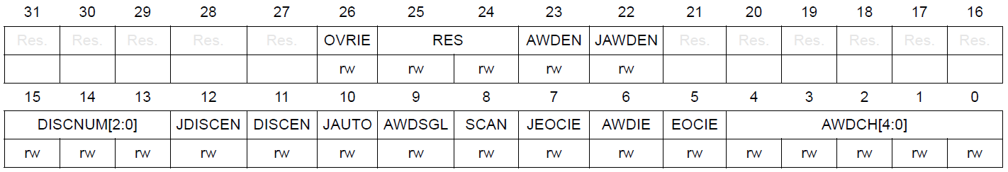
ADC registers
ADC control register 1 (ADC_CR1)
Address offset: 0x04
AWD: Analog watchdog flag
0: No analog watchdog event occurred
1: Analog watchdog event occurred
EOC: Regular channel end of conversion
0: Conversion not complete (EOCS=0), or sequence of conversions not complete (EOCS=1)
1: Conversion complete (EOCS=0), or sequence of conversions complete (EOCS=1)
STRT: Regular channel start flag
0: No regular channel conversion started
1: Regular channel conversion has started
OVR: Overrun
0: No overrun occurred
1: Overrun has occurred

Slide 18
Example schematic
Timer
Memory
TRIG
ADC
DMA
DMA
USART
IN0..15
Data
Data
to PC
Request
IRQ
Software
Start transfer
DMA TC Interrupt Handler

Slide 19
Algorithm
Steps of initialization system
Enable ADC and config required GPIO pins.
Config ADC:
Set work with DMA.
Set start convert by external trigger and choose trigger source.
Set scan mode.
Set number of converting and queue.
Config timer for create trigger event on update.
Config DMA stream for ADC and enable interrupt on TC.
Config USART and DMA for Transmit function.
In DMA IRQ Handler config buffer and start transmission by enabling DMA.

Slide 20
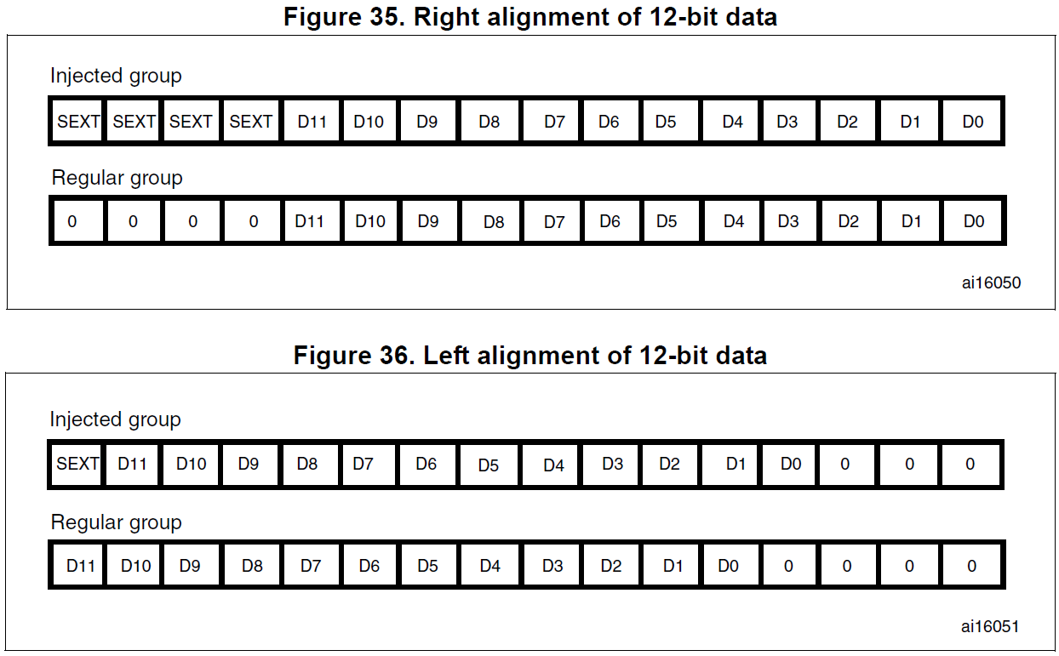
ADC Data alignment

Slide 21
DMA Example
int main()
{ ADC1->CR2 = ADC_CR2_ADON | // Enable ADC
ADC_CR2_DMA | ADC_CR2_DDS | // Enable DMA access
ADC_CR2_EXTEN_0 | // Enable external trigger
ADC_CR2_EXTSEL_X; // Choose external trigger
ADC1->CR1 = ADC_CR1_SCAN; // Set scan mode
ADC1->SQR1 = (NUMBER_OF_CONV - 1) << ADC_SQR1_L_POS;//Set numb of conventions
ADC1->SQR3 = NUMBER_OF_CHANNEL << ADC_SQR3_SQ1_POS | //Set channels queue
NUMBER_OF_CHANNEL << ADC_SQR3_SQ2_POS …;
… //Timer init
TIMX->CR2 |= TIM_CR2_MMS_1; // Enable triggering
…
DMA1_Stream6->CR = DMA_SxCR_CIRC | // Set DMA circ mode
DMA_SxCR_MINC | // Set memory increase mode
DMA_SxCR_MSIZE_0 | // Set memory size to 16-bit
DMA_SxCR_PSIZE_0 | // Set peripheral size to 16-bit
DMA_SxCR_TC; // Enable interrupt on TC
DMA1_Stream6->NDTR = NUMBER_OF_CONV;
// Enable DMA
}

Slide 22
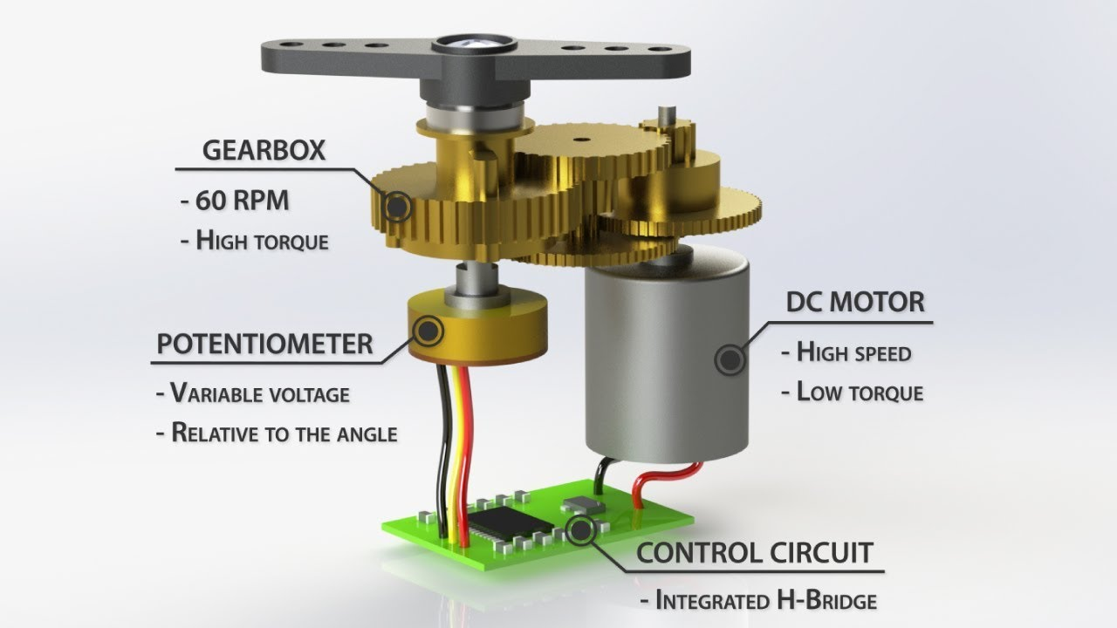
Servo for control

Slide 23
Final system schematic
ADC
H-bridge
Timer
PID
PLANT
Motor with gears
and potentiometer
( 5-wire servo)
u
STM32

Slide 24
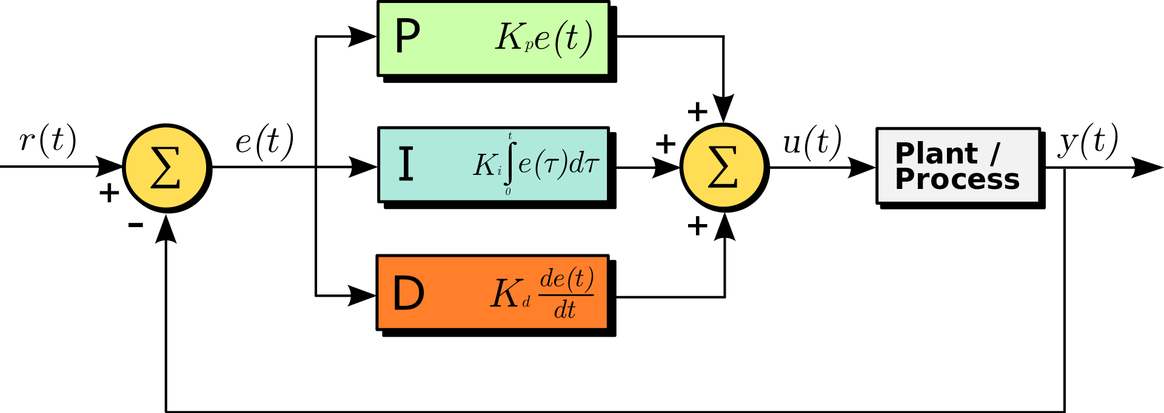
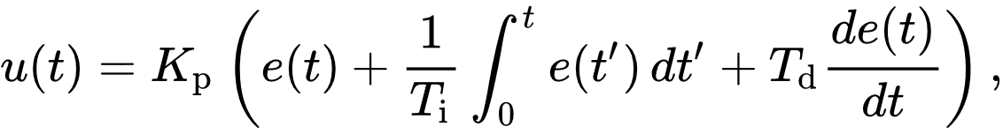
PID

Slide 25

Thank you for attention
www.ifmo.ru

